Slide 1


Employee Attrition Analysis and Prediction
Final project elaborated by: Jessica Barker Akshaya Sathiya Younes Smyej

Slide 2
"Start the retention process when the person is still open to staying and not after they told you they are leaving“ Jeff Weiner

Slide 3

Estimated costs of losing an employee:
1.5 - 2x the employee’s salary
For hourly workers, an average of $1,500 per employee
For technical positions, 100-150% of salary
Recruitment - finding, talking, choosing, hiring
Starting off - training costs, time spent
Less work getting done - it might take 1-2 years for a new person to work as well
Business goes down - new workers might not be as good at fixing problems and dealing with things
Culture changes - when someone leaves, others wonder why and feel more tired

Slide 4



We want to answer...
What can companies do to prevent losing employees
Why do employees leave?
What factors characterize employee attrition?

Slide 5

Employee Attrition
Understanding why employees leave...
● Unsatisfying compensation and benefits
● Lack of development opportunity
● Lack of work-life balance
● Lack of recognition
● Poor management
● Poor work conditions

Slide 6

Our Data
IBM data experts created information about HR employees, including:
1,470 instances (entries) and 35 features (details)
Personal employee info like age, marital status, distance from home, gender, education, etc.
Answers from surveys about things like job satisfaction and work-life balance
Work-related data such as monthly income, years at the company, job role, and travel.

Slide 7

Exploratory Data Analysis (EDA)
Count plot of 'Attrition' distribution shows higher 'No' than 'Yes'.
Imbalanced classes suggest potential model performance challenges.
Addressing class imbalance is essential for accurate prediction.
EDA helps us understand dataset characteristics and informs subsequent analysis.

Slide 8
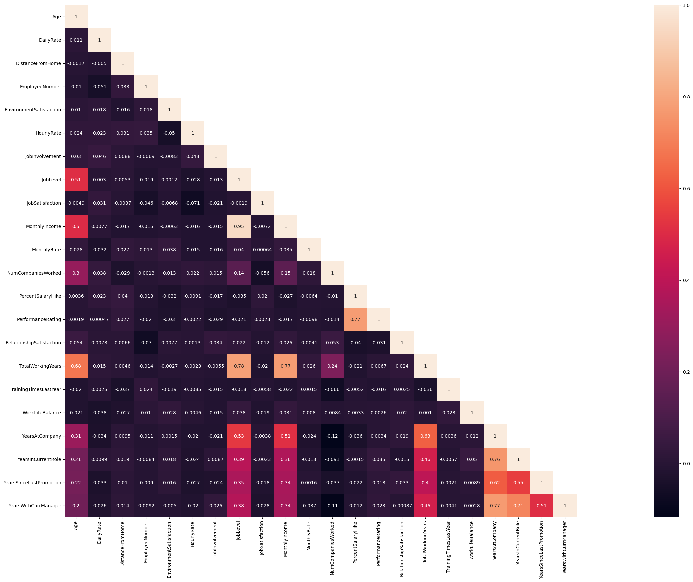
Correlation Matrix

Slide 9
Attrition Analysis by Categories
Analyzing attrition by categories uncovers initial patterns, suggesting potential drivers of employee turnover. These insights guide subsequent analysis and strategy development:
Gender
Age
Years in Current Role
Total Working Years
Years since Last Promotion
Monthly income
Top 3 Departments with Attrition

Slide 10
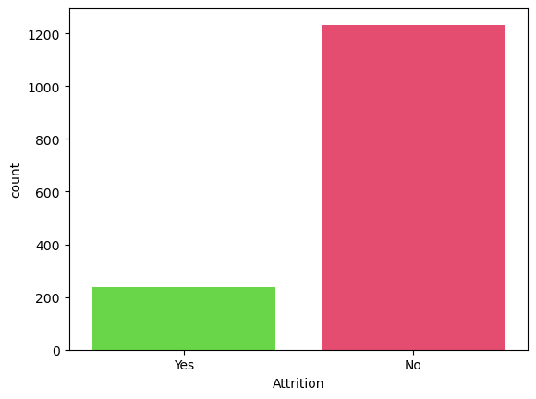
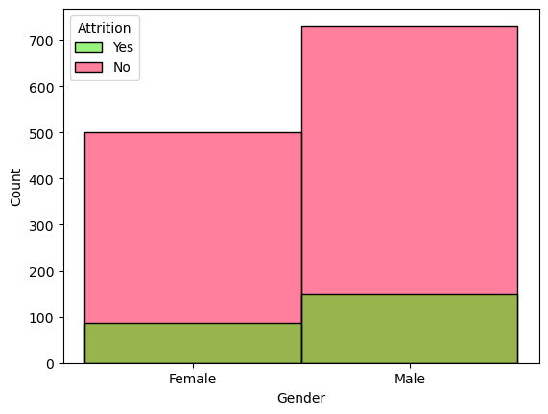

Overall Attrition and Attrition by Gender

Slide 11
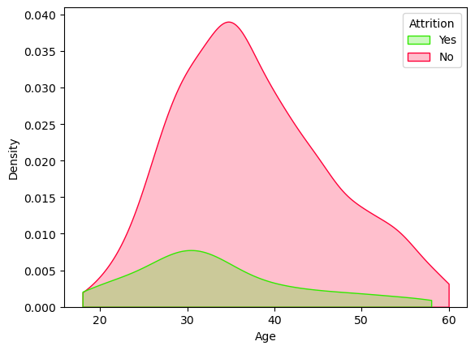
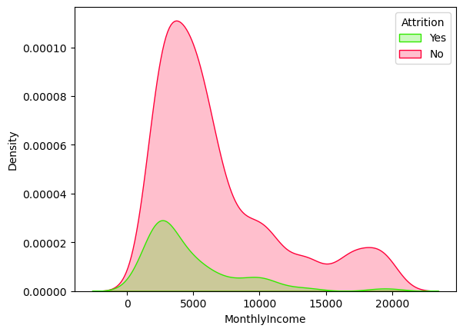
Attrition Analysis by Age & Monthly Income

Slide 12
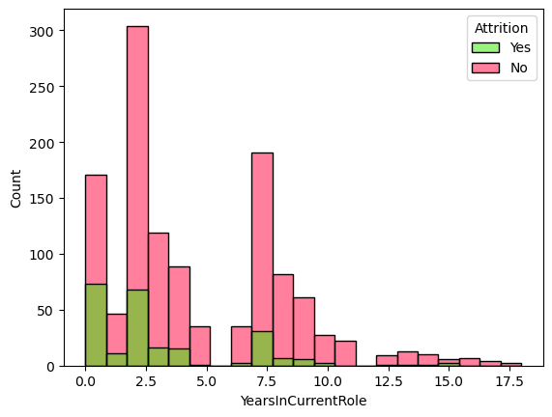
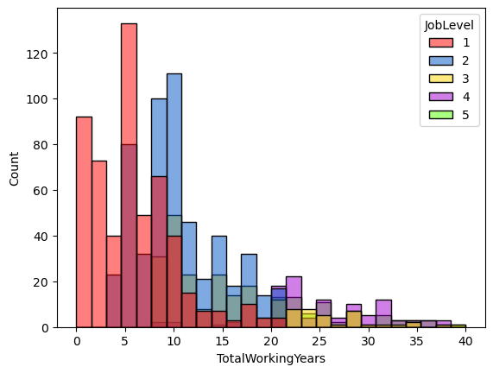
Attrition Analysis by Years in Current Role & Total Working Years

Slide 13
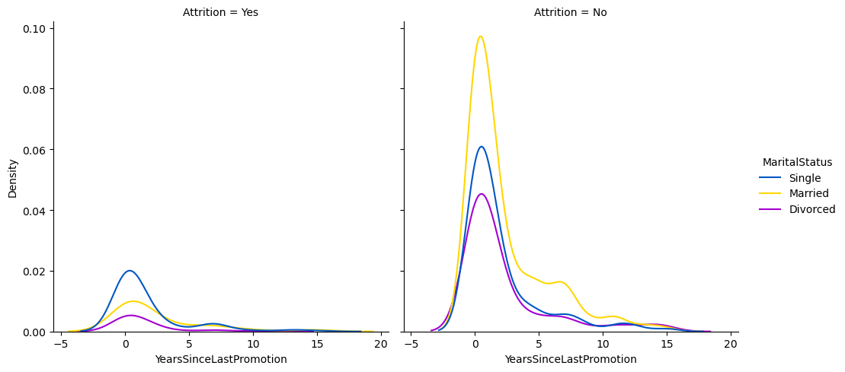
Attrition Analysis by Years since Promotion Single, Married, and Divorce

Slide 14
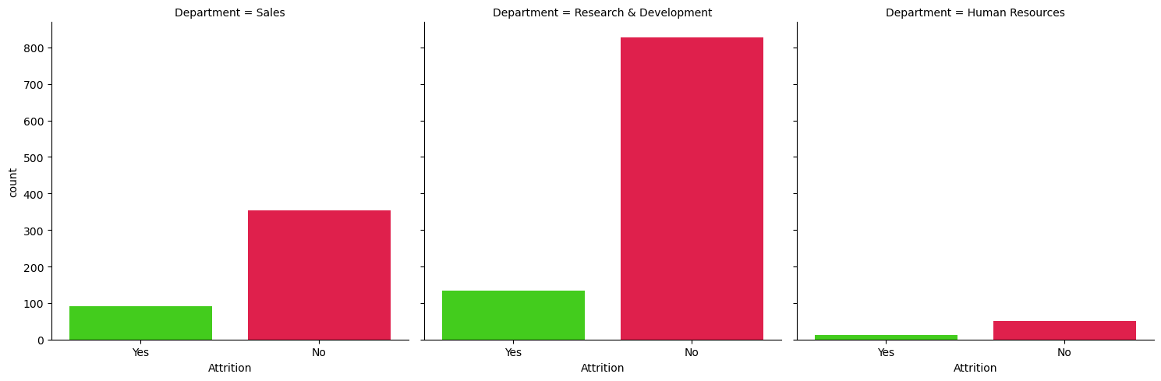
Attrition Analysis on the top three Departments

Slide 15
Random Forest
We used this model because it is good for binary classification, and for its ability to determine feature importance, which we planned to use to guide our exploratory analysis. It ended up with an 87% accuracy, but due to the low recall, we did not end up using this model. The classification report, confusion matrix, and feature importance can be seen below:
Accuracy Score : 0.8777173913043478
Classification Report
precision recall f1-score support
0 0.89 0.98 0.93 321
1 0.58 0.15 0.24 47
accuracy 0.88 368
macro avg 0.74 0.57 0.59 368
weighted avg 0.85 0.88 0.84 368

Slide 16
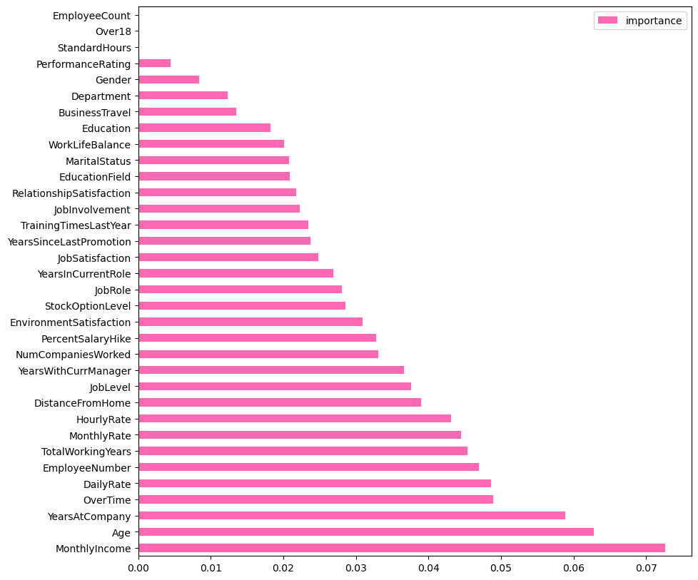

Random Forest Model Prediction Bar Graph

Slide 17
XGBoost
We used this as a second model because it is also good for binary classification, and ability to handle complex relationships within the data. XGBoost has built-in regularization techniques, such as L1 and L2 regularization, that can help prevent overfitting. We chose to use this mode because it had a higher accuracy rate of 89% and a higher recall rate of 32% .
Accuracy Score : 0.8858695652173914
Classification Report
precision recall f1-score support
0 0.91 0.97 0.94 321
1 0.60 0.32 0.42 47
accuracy 0.89 368
macro avg 0.75 0.64 0.68 368
weighted avg 0.87 0.89 0.87 368

Slide 18
THANK YOU!
Any questions?

